Slide 1
Co-production of knowledge for sustainable adaptation
Halvor Dannevig, Mari H. Korsbrekke, Grete K. Hovelsrud
Notes:
Its certainly a rural and peripheral phenomena

Slide 2
Why is co-production needed in the sustainability sciences?
Critique of the linear science to policy model (the positivist model of science advice) (Bush 1945).
Dealing with uncertainty requires value judgement. Stakeholder’s values as important as scientist (Funtowitz and Ravetz 1994).
For knowledge to result in action it must be credible, salient and legitimate (Cash et al. 2003).
The UN 2030 Sustainable Development Goals

Slide 3
Approaches to production of usable knowledge for transition to sustainability
Mode 1 vs Mode 2 of knowledge production (Gibbons)
Post-normal science (Funtovitz and Ravetz)
Boundary work (Cash, Clark,
Co-production of knowledge
Descriptive approach (Jasanoff 2010)
Vs
Normative approach (i. e. Dilling and Lemos 2011)
Interventionist research and participatory action research
Notes:
Mode 2= problem oriented, transdisciplinary

Slide 4
Purpose of the paper
Limited research on the importance of co-production of knowledge for the SDGs – incl the «adaptation to climate change sub-targets» of the SDGs
Does the SDG agenda promote participatory approaches and co-production of knowledge for adaptation?
How processes of co-production reveal potentials for levelling of power asymmetries?
Does the SDG agenda calls for a more activistic role of researchers?
”scientists need to engage in informed agitation to realize a transition to sustainability” Amartaya Sen, 2013.

Slide 5
Systematic review
48 journal articles and book chapterd reviewed
18 from Scopus and Web of Science
Only two papers on the search string «Adaptation» «co-production» »SDG»
16 on «Adaptation» «co-production» »sustainab»
25 from Google Scholar
«Adaptation» «co-production» »SDG»
Coded in an excel sheet (key words, field of study, methods, approach to co-production, SDG tradeoffs and synergies (maladaptation), SDG subtargets etc)

Slide 6
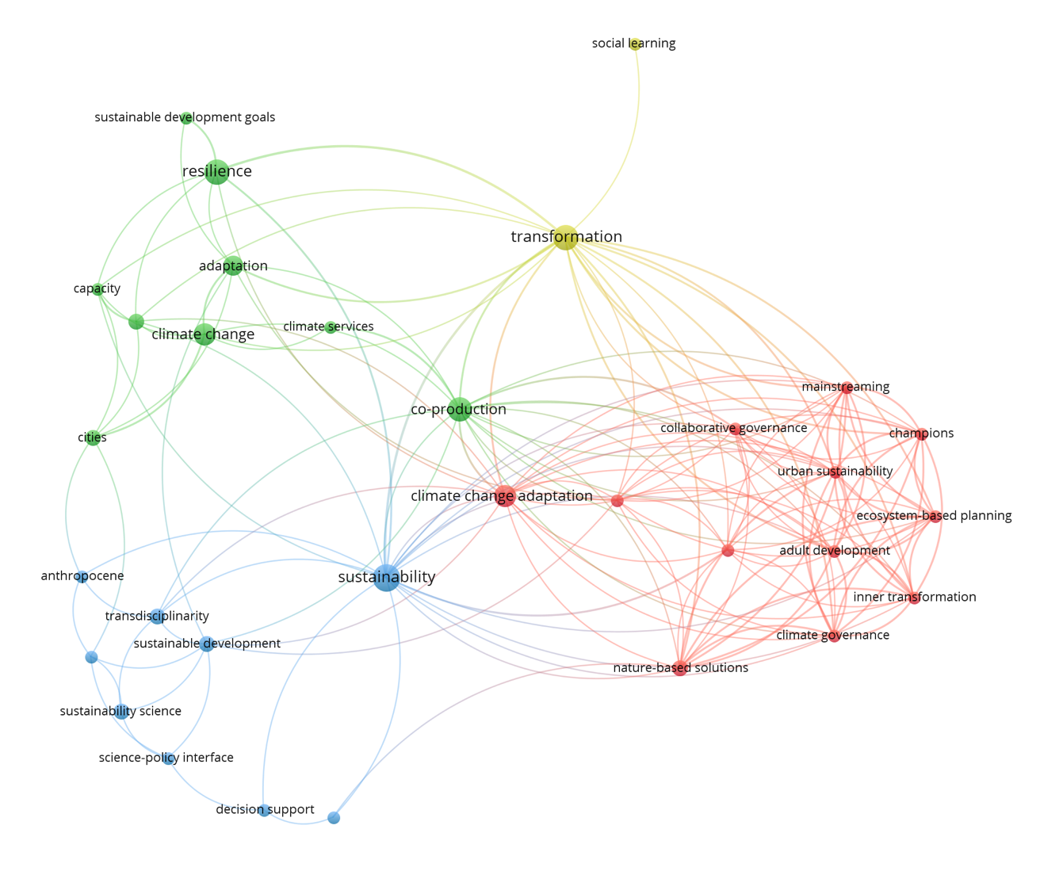
Relationships between topics in the corpus

Slide 7
The SDG agenda, co-production and adaptation
Still a limited field – few articles that discusses co-production for adaptation in the context of the SDGs or sustainability
All studys applies co-production in the normative sense
Limited reflections on the importance of the SDG agenda for co-production of knowledge.
Several approaches to co-production of knowledge for adaptation found
->But the SDG agenda is not having an impact on the the approach and methods used (e.g solving trade-offs or utilizing benefits between sub-targets; more interventionist approaches).

Slide 8
Methods for co-production identified
Method | Characteristics | Number of publications in corpus
Labs | Testing solutions with stakeholders | 4
Workshops (stakeholder-, scenario-, participatory, -) | Events that bring researchers and stakeholders together, employing various methods for facilitating collaboration and mutual learning | 16
Science-policy platform | Enduring meeting places for researchers and stakeholders, similarities with networks | 1
Interdisciplinary Teams, task groups |  | 1
Participatory action research | Interventionist approach where researchers engage in development of new policy or solutions | 1
Networks | Formalized collaborations between stakeholder organizations and research institutions for exchange of knowledge | 5
Incubators | Similarities with labs (see above) | 1

Slide 9
Co-production and power
How adaptation can level power assymetries – and the role of participatory approaches in this process:
Scoones et al 2020: Transformative processes of adaptation including co-production illuminates power relations.
Butler et al. 2015: Co-production for adaptation & povery alleviation through a participatory process designed to tackle assymetric social relations
= still a limited field of enquiry!

Slide 10
A changing role for the researcher?
From facilitator of processes of co-production to «informed agitator»?
Has the SDG agenda led to more internventionist approaches?
Many examples of interventionist approaches to adaptation, incl co-production
Our review does not indicate that the SDG agenda is increasing an interventionist approach.

Slide 11
Conclusion
Transition to sustainable adaptation requires an transformative research agenda that include interventionist approaches.
But the SDG agenda is not contributing to scholarship on this
Limited research that reflects on the role of co-production for localizing SDG subtargets on adaptation to local context
There is a lack of interest in how trade-offs and synergies between adaptation and other SDG-targets should be handled.

Slide 12
hda@vestforsk.no
@HalvorDannevig

