Slide 1
SCA-Noradapt The Scientific Advisory Board (SCA) of Noradapt (the Norwegian Research Centre on Sustainable Climate Change Adaptation (Noradapt)
Workshop on sustainable climate adaptation, Noradapt, 5. October 2021
Notes:
Two decades of pioneering research has put WNRI at the national forefront of research on climate change adaptation and sustainability. In addition to conducting several national and international research projects in the field, WNRI has carried out research and development projects for local, regional, and national government bodies, including both public and private sector organizations. WNRI also contributes to the only master’s programme in Norway which includes both climate change adaptation and mitigation, taught at the Western Norway University of Applied Sciences.

Slide 2
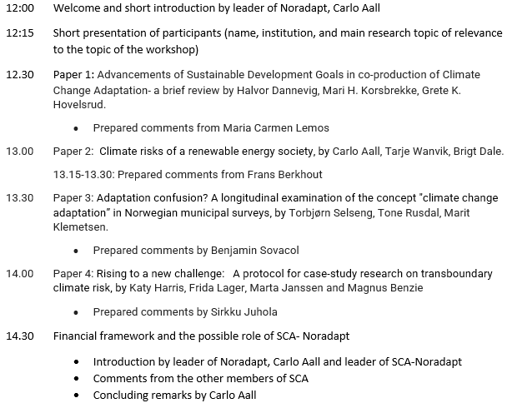
Program

Slide 3
Members of the Scientific Advisory Board
Member | Institution | Email
Sirkku Juhola (leader) | Helsinki universitiet | sirkku.juhola@helsinki.fi
Richard Klein | Stockholm Environment Institute | richard.klein@sei.org,
Maria Carmen Lemos | University of Michigan | lemos@umich.edu
Frans Berkhout | King’s College London | frans.berkhout@kcl.ac.uk
Benjamin Sovacool | University of Sussex | B.Sovacool@sussex.ac.uk

Slide 4
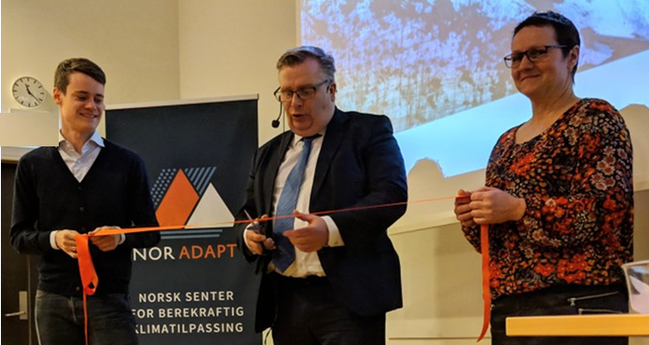
Noradapt established in 2018
Managed by Western Norway Research Institute in Sogndal.
The center aims to offer research-based answers to society’s needs in the face of a changing climate.
The Centre emphasizes sustainability in its approach to climate change adaptation, promoting adaptation measures that do not conflict with the goal of sustainable development.
Government annual basic funding of 5 million NOK since 2019
Formally opened by the state secretary of the ministry of Climate and Environment in December 2018
Notes:
In the Norwegian context, Western Norway Research Institute was a pioneer in carrying out research on how society could respond to climate change through adaptation measures. Since 2005, we have cooperated with municipalities, private and public enterprises, various organizations and national authorities to ensure that climate change adaptation is conducted on a sound scientific basis. WNRI’s scientific contribution is social science-based, but we work in close cooperation with climate experts in the natural sciences.

Slide 5
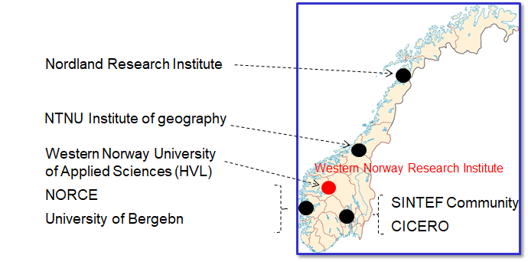
Our research PARTNERS
Bergen
Notes:
Noradapt also seeks to maintain a high degree of user collaboration, through involving representatives of public bodies such as the Norwegian Environmental Protection Agency, the Norwegian Water Resources and Energy Directorate (NVE), the Norwegian Public Roads Administration, KS (municipal sector organization), and the County Governor of Vestland. Representatives of private business and NGOs will also be invited to take part in our activities.
The Centre will have a USER GROUP that will interact with the Centre and give responses to strategy documents, activities and project proposals, take part in proposals, and so on.
We have close collaboration with municipalities and county municipalities, county governors as regional authorities in Norway.

Slide 6
The management model

Slide 7
The financing and activity model
Internally financed by the annual earmarked funding
Fixed activities (50%)
Center management
User contacts
Outreach
Climate monitor
International scientific advisory board
Variable activities (50%)
Smaller projects
(< 100.000 NOK)
Larger projects
(100 000 NOK – 3.000.000 NOK)
Externally financed (with 2 or more Noradapt partners)
Consulting assignments
Norwegian research or development projects
International research projects

Slide 8
The Resource basis for Noradapt
Goal
Situation as for 2021-2023
Total volume 5 250 000 Euro
25/75 share internal/external funded projects
25/75 share research/r&d
16 % International projects

Slide 9
Headline activities of 2021
Scientific publications
Special collection of WCAS
Noradapt research projects
TransAdapt: A 4 year project on transboundary climate risks (2021-25)
ClimateInteraction: Conflicts and synergies between climate change adaptation and mitigation (2020-23)
Climate monitor: a data generator!
www.klimamonitor.no monitoringing attitudes, knowledge and practices on climate change adaptation in Norway (pre-project in 2020, 2021 first year in full operation)
Annual survey to public government) national, regional, local), business (using consultancy firms as “listening posts”), households (small part of an ongoing national panel study)
Network, dialogue and outreach
The webinar series “Noradapt-hour” every 4 weeks (started 2021)
Annual 2 day conference (since 2015) on climate change transformation (cf. www.klimaomstilling.no)
Teaching and training
International 2 year master in climate change transformation (https://www.hvl.no/en/studies-at-hvl/study-programmes/2021h/maccm/)

Slide 10
Financial framework and roles of SCA-Noradapt
Financial framework
Basic financing of SCA (individual contracts with each member)
Additional project financed activities (e.g. partner in Noradapt projects)
Potential roles
Take part in 3-4 meetings / workshops annually, possibility of 1 physical meeting in connection with the general assembly of Noradapt
Reviewing proposals for (large) internally funded Noradapt projects
Commenting and/or co-editing journal articles
Reviewing book proposals / book chapters
Editing individual books
Commenting on and/or becoming partners in external proposals (to Norwegian research council, EU etc)
Being a host for young research mobility

