Slide 1
Climate risks of the transition to a renewable energy society Presentation of a paper at the digital workshop on sustainable climate adaptation in connection with the first meeting of the Scientific Advisory Board of Noradapt, 5.10.2021
By Carlo Aall (Vestlandsforsking), Tarje Wanvik (Universitetet i Bergen), Brigt Dale (Nordlandsforsking)

Slide 2
Research design and method
Assumption
All other factors being equal, in theory a 100% renewable energy society will be more vulnerable to climate variability than a 100% fossil energy society
Research questions
How do the policy and research literature address climate risks associated with a transition to a future renewable energy system?
How do Norwegian energy system stakeholders reflect on climate risks associated with a transition to a future renewable energy system?
What—if any—knowledge gaps should be filled with respect to climate risks associated with the transition to a future renewable energy system?
Data
Review of policy documents in Norway and the EU from the two policy fields: Energy ,and climate change adaptation
Review of international research literature from two streams of literature : Energy transition, and climate change adaptation
Telephone interview of stakeholder representatives from two environmental organisations, two state-owned infrastructural agencies, three regulatory bodies, four energy producer interest groups, and one financial support apparatus
Status of paper
Still under revision

Slide 3
What does the current research literature say?
One-sided focus with respect to energy system
Mostly about climate risks relating to the production side
Biased focus with respect to climate risks
More about transition than physical climate risks
The extent that physical climate risks are addressed
Mostly derived from applying future climate conditions on the current energy system
Mostly about energy-sub systems, rarely addressing the totality of the energy system
Much about positive consequences (how climate change may increase potential for producing renewable energy)
To the extent that adverse consequences are addressed, much about extreme weather events and impacts power supply lines

Slide 4
What does the current policy literature say?
Example Norwegian policy literature
Future climate conditions is most applied to the current energy system
The main messages are that climate change may prove beneficial for the Norwegian energy system, by the combined effects of increasing hydro energy production capacity (with greater precipitation) and lowering energy use for heating (with increased temperatures)
Also points to possible adverse impacts of climate change, most importantly reduced power supply security (due to increased likelihoods of various extreme weather events) and increased variations in power production (due to increased climate variability)
Example EU policy literature (EEA, 2019)
“… (m)any extreme weather events, including heat waves, heavy precipitation events, storms and extreme sea levels, are projected to increase in frequency and/or magnitude as a result of climate change. Without appropriate adaptation measures, direct economic losses to the European energy system could amount to billions of euros per year by the end of the century, with much larger indirect costs”

Slide 5
What did our informants say?
The future supply of electricity will not represent a problem for Norway
More focus on transition (e.g. conflicts with development of new renewable energy and biodiversity, the loss of jobs from closing the oil and gas industry in Norway, the extent that CCS technology will manage to deliver in time) than on physical climate risks
The transition to a 100% renewable energy system will reduce rather than increase the physical climate risks of the Norwegian energy system
Limited focus on the consumer side of the challenges relating to the energy transition
The informants are divided in their views on whether increased integration of the Norwegian energy system in a European renewable energy market will increase or reduce the physical climate risk

Slide 6
Current focus - and ideas about the possible need for change
Perspectives | Only | Mostly | Equal | Mostly | Only
Climate system | Current |  |  |  | Future
Policy actors Norway |  |  | X
Research literature |  |  | X
Energy system | Current |  |  |  | Future
Policy actors Norway |  | X
Research literature |  | X
Impact of climate change | Positive |  |  |  | Negative
Policy actors Norway |  | X
Research literature |  |  | X
Economic perspective | Supply side |  |  |  | Demand side
Policy actors Norway |  | X
Research literature |  | X
System boundaries | Sub-systems |  |  |  | Holistic
Policy actors Norway |  | X
Research literature |  | X
Geographical boundaries | National |  |  |  | International
Policy actors Norway | X
Research literature |  | X
Type of climate risk | Transition |  |  |  | Physical
Policy actors Norway |  | X
Research literature |  | X

Slide 7
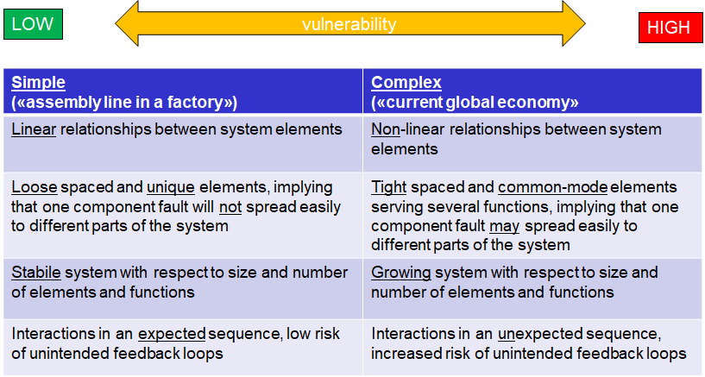
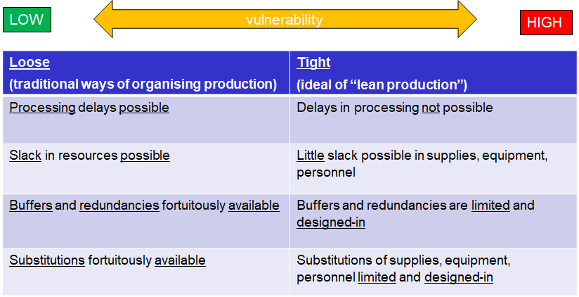
A proposed theoretical framework for analysing climate risk of a 100% renewable energy system
Perrow, C. (2007). The Next Catastrophe: Reducing Our Vulnerabilities to Natural, Industrial, and Terrorist Disasters. Princeton: Princeton University Press.

Slide 8
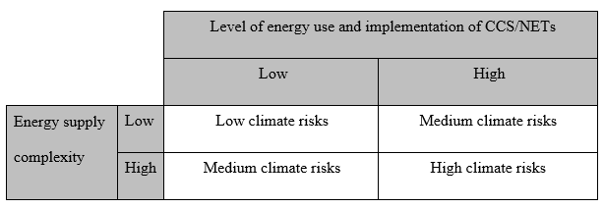
A proposed theoretical framework for analysing climate risk of a 100% renewable energy system

Slide 9
Two climate risk scenarios
vulnerable
?
?
resilient

